Slide 1

Online Voter System Development
Following the Software Development Life Cycle (SDLC)
-BY:
Mohit Kumar
Lovepreet Singh
Nikhil Pradhan
MK

Slide 2

Introduction to SDLC
Definition
Importance
Benefits
SDLC is a structured approach to software development, providing a roadmap for creating high-quality software products. It encompasses a series of well-defined phases, each with its specific objectives and deliverables.
Ensures systematic project execution by breaking down complex projects into manageable stages. This structured approach helps in better planning, resource allocation, and risk management throughout the development lifecycle.
Improved efficiency, reduced costs, enhanced quality. SDLC leads to better resource utilization, minimizes rework, and ensures that the final product meets the desired quality standards and business objectives.

Slide 3





Planning: Understanding the Goal
Define Purpose
Identify Problem
Team Roles
Objectives of the system
Address voting challenges
Assign responsibilities
Feasibility
Assess technical, economic aspects

Slide 4
Requirement Analysis
Gather Info
Expectations
Document
Meetings
Collect detailed information from stakeholders and users to understand their needs and expectations for the online voting system.
Define clear expectations for system features, including user registration, secure voting processes, and accurate results reporting.
Document all gathered requirements using collaborative tools such as Google Docs and GitHub for version control and easy access.
Conduct regular meetings with stakeholders to provide updates on the requirement analysis process and gather feedback.
Conduct surveys, interviews, and workshops to gather comprehensive requirements.
Ensure the system complies with all relevant legal and regulatory requirements for online voting.
Create a comprehensive requirements specification document that serves as a blueprint for the development team.
Use these meetings to clarify any ambiguities and ensure that the development team has a clear understanding of the project goals.

Slide 5
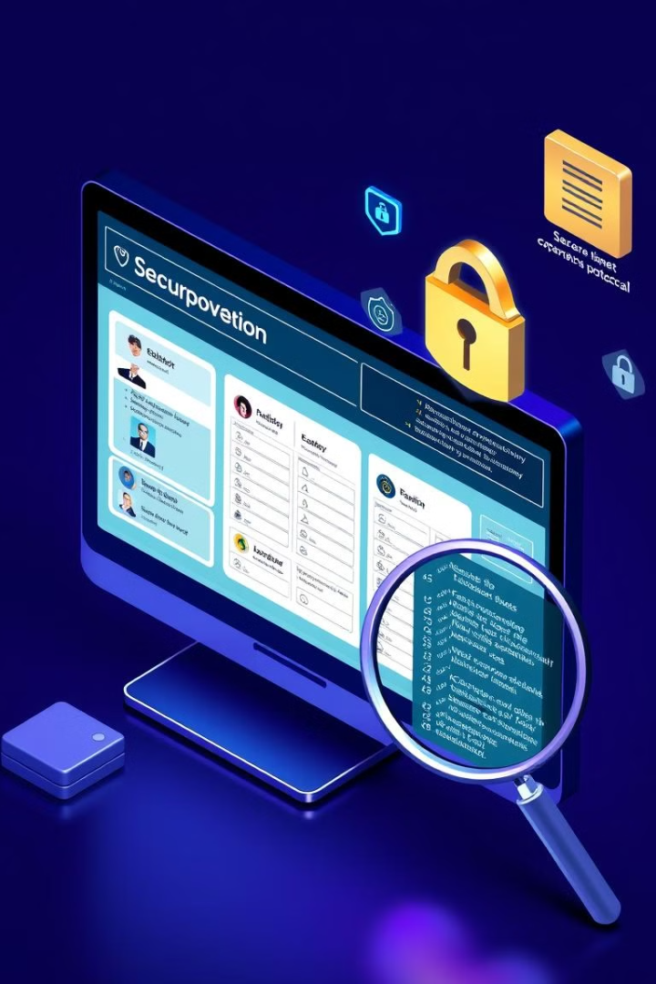
Design: Creating a Blueprint
Wireframe
Website layout sketch
DB Structure
Voters, Candidates, Votes tables
Technologies
HTML, CSS, JavaScript, Python

Slide 6

Implementation: Coding the Project
Code: Write clean, well-documented code following established coding standards. Use appropriate data structures and algorithms to ensure efficiency and scalability.
Version Control: Utilize Git for version control, creating branches for new features or bug fixes. Regularly commit changes with clear and concise commit messages.
Peer Review: Conduct thorough code reviews to ensure code quality, identify potential bugs, and maintain consistency across the codebase.

Slide 7




Testing: Ensuring Quality
Integration Testing
UAT
Components together
End user feedback
Unit Testing
Security Testing
Individual components
Data protection
2
3
1
4

Slide 8



Deployment: Launching the System
Prepare
1
Server Setup
Deploy
2
Make system live
Monitor
3
Post-Deployment

Slide 9

Maintenance: Long-term Success
1
Regular Updates and Bug Fixes
Address any issues reported by users or identified through system monitoring. Implement security patches to protect against vulnerabilities. Enhance system performance based on usage analysis.
2
Continuous User Feedback Integration
Collect user feedback through surveys and support channels. Prioritize feature requests and improvements based on user input. Conduct usability testing to ensure a smooth user experience.
3
Comprehensive Documentation and Change Records
Maintain detailed documentation of all system updates and changes. Track issues, resolutions, and user feedback for future reference. Update user manuals and training materials to reflect system enhancements.

Slide 10

Conclusion
SDLC Summary
Future Work
Successfully navigated SDLC, delivering a robust and secure online voter system through careful planning, design, and maintenance.
Enhancements: blockchain security, multilingual support, and a mobile app for accessibility.
Scalability
Designed for scalability, handling growing voters and elections via cloud infrastructure, optimized database, high availability and performance.

